Slide 1
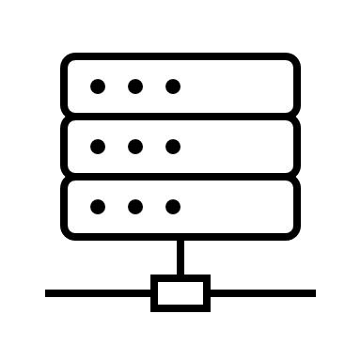



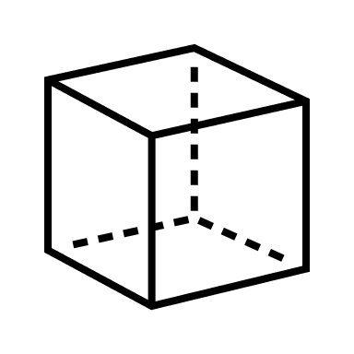








Form factor evolution plus advancements in Compute, Connectivity provides Gamers with a richer, more frictionless gaming experience
Conventional Gaming
Cloud Gaming
Thin Client Gaming (Nyx)
Display Compute Gaming
Server
2
2
2
Game Server
Store
Game Logic Server
Game Database
Game Services
Game Logic Server
Game Database
Game Services
Game Logic Server
Game Database
Game Services
Compute
2
2
Internet
Internet
Thin Client
Internet
User
Controllers
Displays
Controllers
Displays
Controllers
Displays
Displays
Controllers
1
3
1
3
1
3
3
2
1
User Experience | Buy Once, Play Forever Network connectivity needed only for Multiplayer Mode | Play on any device such as TV, PC, or mobile Access multiple games through subscription | Transition across gaming devices in real-time Smoother gaming experience due to reduced transactions over the Internet | Game from almost anywhere with a display Smoother gaming experience due to reduced transactions over the Internet Affordable gaming experience through cost-effective HW
Success Criteria | HW must meet minimum specs Costly initial HW investment and subsequent upgrades | Fast and stable internet connection Affordable game, compute subscription model | Optimized shared computing between Thin Client and Game Server Fast and Stable Internet Connection Affordable game, compute subscription model | Optimized shared computing between Thin Client and Game Server Fast and stable internet connection Affordable game, compute subscription model
1
Input
2
Processing
3
Output

